Slide 1
Water
NDFS 5560
Fall 2015

Slide 2
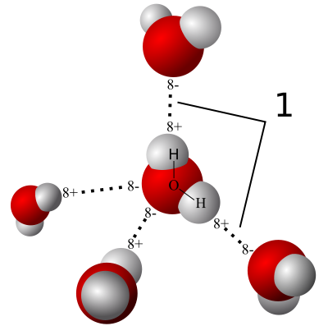
Water
2 hydrogen, 1 oxygen atoms
Solid, liquid, gas at Earth temperatures
Used in many aspects of food processing
Excellent solvent
http://en.wikipedia.org/wiki/Water

Slide 3
Basic chemistry
What is molecular weight of water?
18.02
What are units?
Mol? What is Avogadro’s number?
There is 6.02 ×10²³ molecules (1 mole) in 18.02 grams of water
18.02 g/mol

Slide 4
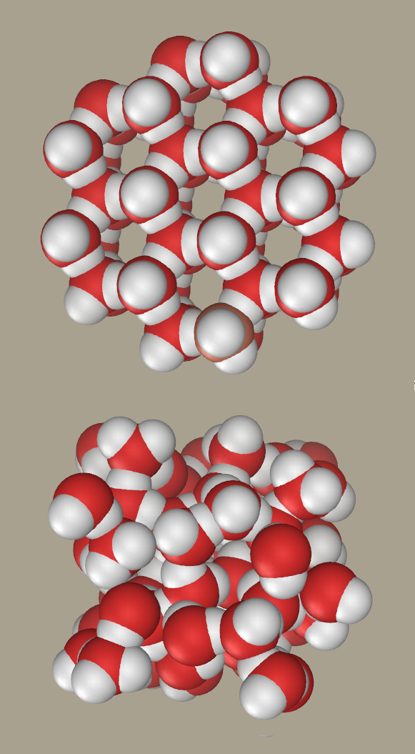
Water-Basic science
Melting point
Boiling point
Heat of fusion
Heat of vaporization
Surface tension
Heat capacity
Thermal conductivity

Slide 5
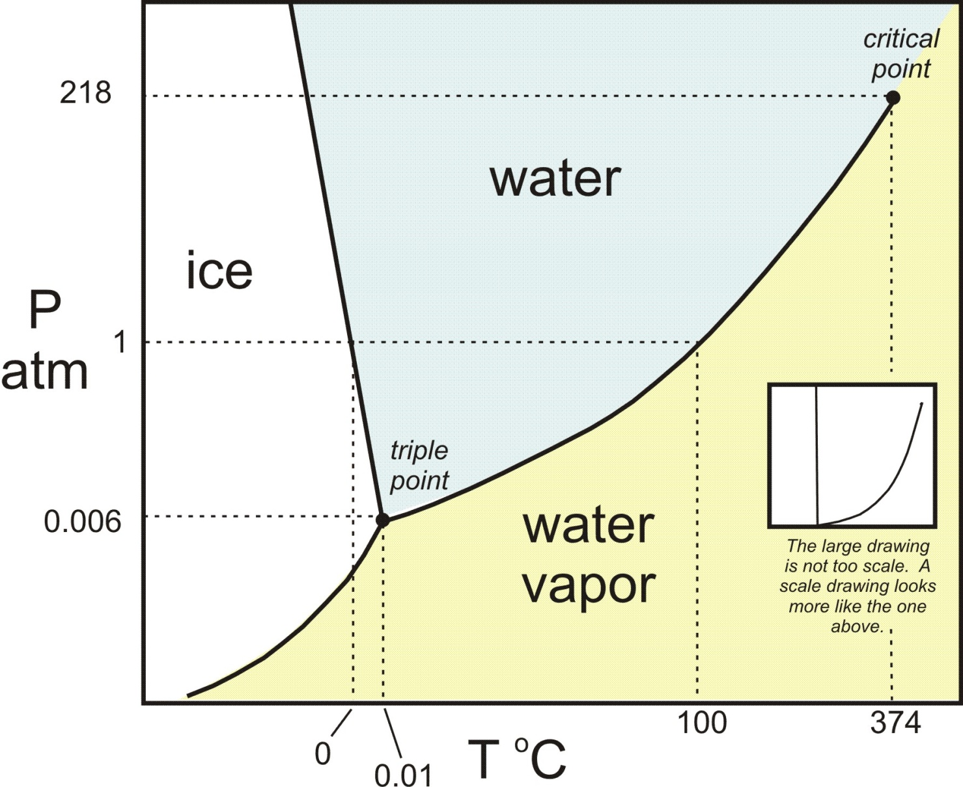
Water phase diagram
http://serc.carleton.edu/research_education/equilibria/phaserule.html

Slide 6
Water properties and food processing
Pressure cooking
Freeze drying
http://serc.carleton.edu/research_education/equilibria/phaserule.html

Slide 7
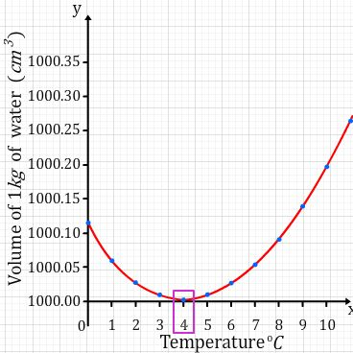
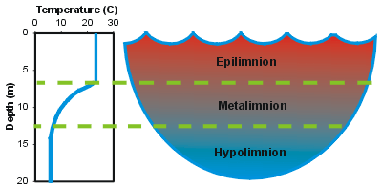
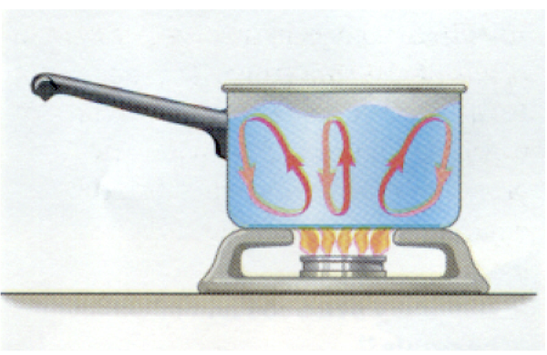
Water density and heat
Water is most dense at 4° C
Water is poor thermal conductor
In open water, heat at surface conducts slowly downward
Water heated from the bottom will convect upward

Slide 8
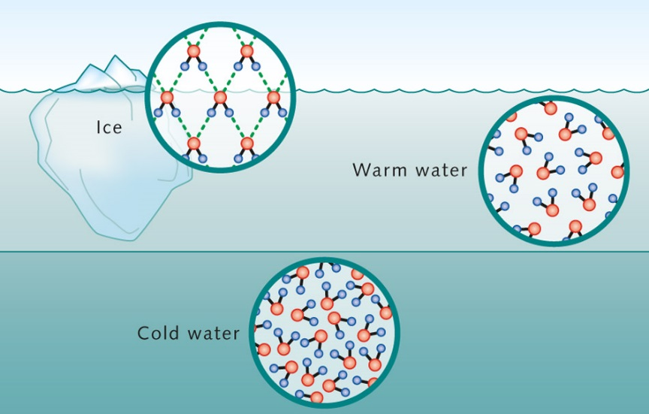
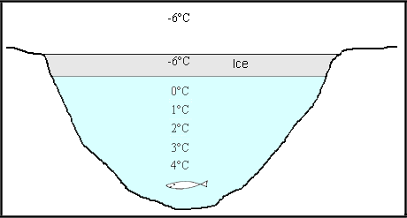
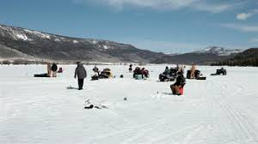
Ice is less dense than water

Slide 9
Water
+
-
6.187 × 10⁻³⁰ C m (Coulomb meter)
Polarity, dipole moment and hydrogen bonding result in unique properties of water
https://www.boundless.com/chemistry/advanced-concepts-of-chemical-bonding/molecular-geometry/lone-electron-pairs/

Slide 10
Hydrogen Bond: Definition
Weak (~4.5 kcal/mole) polar attraction between hydrogen bonded to electronegative atom (F,O,N) and another electronegative atom.
Covalent bond ~330-380 kj/mol
Van der Waals ~0.01 to 0.3 kcal/mol

Slide 11
Hydrogen bonds structure water
High strength
Short range
Angular dependence

Slide 12
Hydrogen bond effects
Compound | MW | Melting pt. (°C) | Boiling Pt (°C) | Phase @ 22°C
Methane (CH₄) | 16 | -182 | -161 | Gas
Methanol (CH₃OH) | 32 | -98 | 65 | Liquid
Water | 18 | 0 | 100 | Liquid

Slide 13
Hydrogen bonding in foods

Slide 14
Bound water
Association of water with hydrophilic and hydrophobic regions constrains movement of water
Not as easy to remove as free water
‘Bound water is that which exists in the vicinity of solutes and other non aqueous substances and has properties differing significantly from those of “bulk” water in the same system’
Food Chemistry,2nd edition. O. Fennema. Ed. !985, page 37.

Slide 15
Hydrogen Bond: Examples
Hydroxyl-Hydroxyl
Hydroxyl – Carbonyl
Peptide
Amide – hydroxyl
Ionic H bond -COO⁻
Ionic H bond -NH₃⁺
Methylene-Hydroxyl

Slide 16
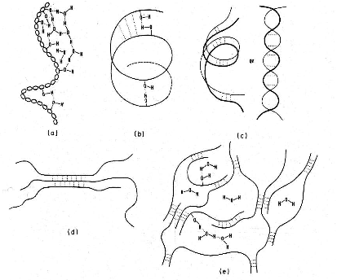
H-bonds in Starch
Schemes of intermolecular hydrogen bonding of polysaccharides
Food Chemistry,2nd edition. O. Fennema. Ed. !985.

Slide 17
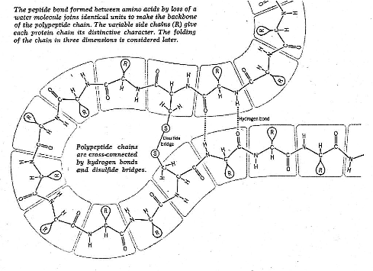
H-bonds in Proteins
Structure & action of proteins, by Dickerson & Geis, 1969.

Slide 18
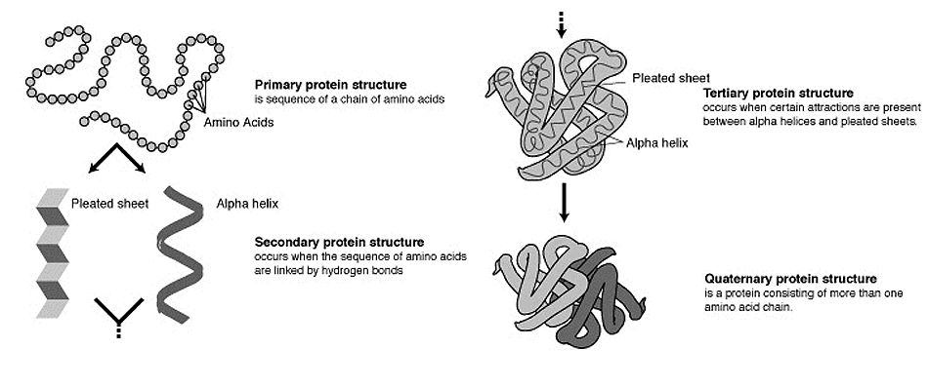
Protein Structures

Slide 19
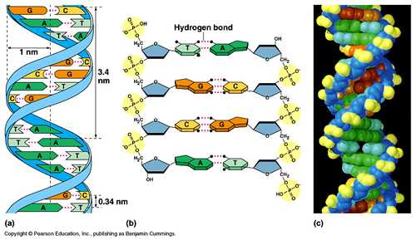
H-bonds in DNA

Slide 20
Heat stable amino acid sequence
Q: How are enzymes from thermophilic organisms able to function and remain stable at temperature approaching 100°C ?
A: An increase in number of hydrogen bonds and/or salt bridges making protein structure (enzyme) more compact.

